Slide 1

TWITCH ETL
Lilit Akopyan, Natalie Cabayan & Ben Huang

Slide 2
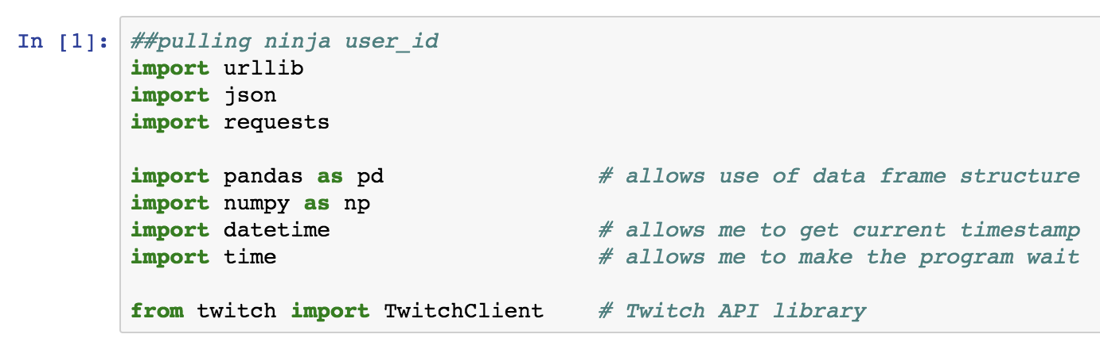
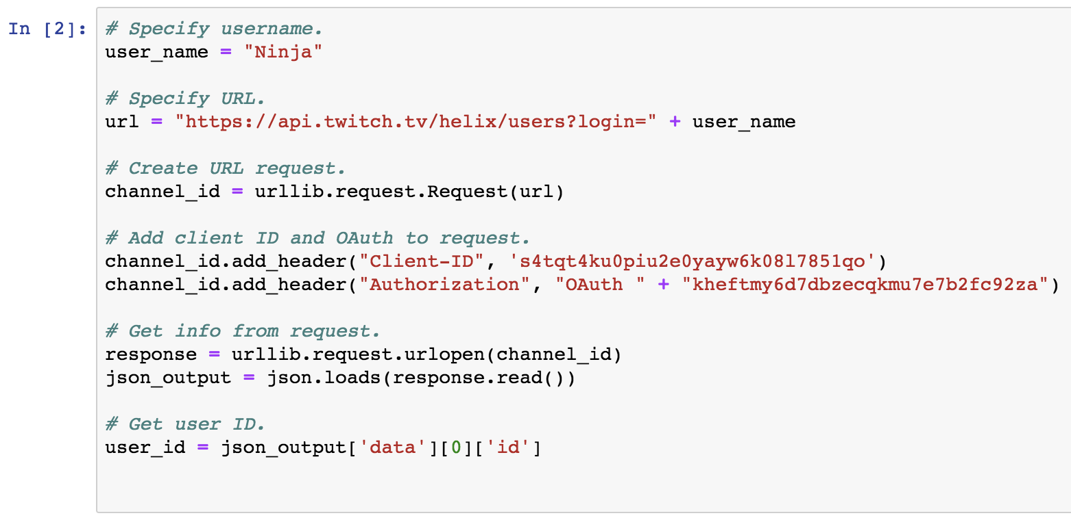
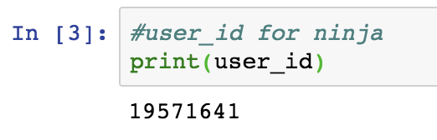
Identify Twitch User_ID

Slide 3
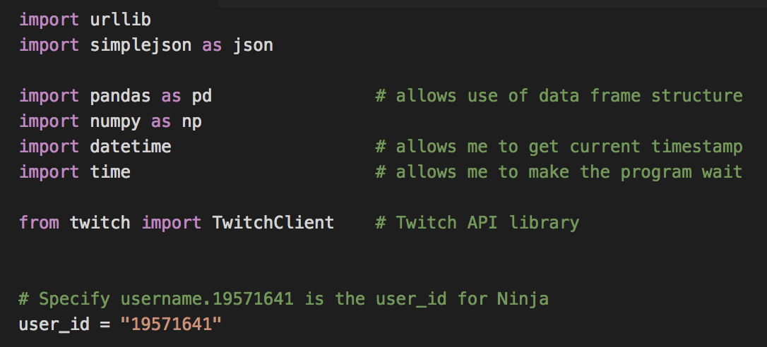
Twitch API Script
Step 1: Import dependencies

Slide 4
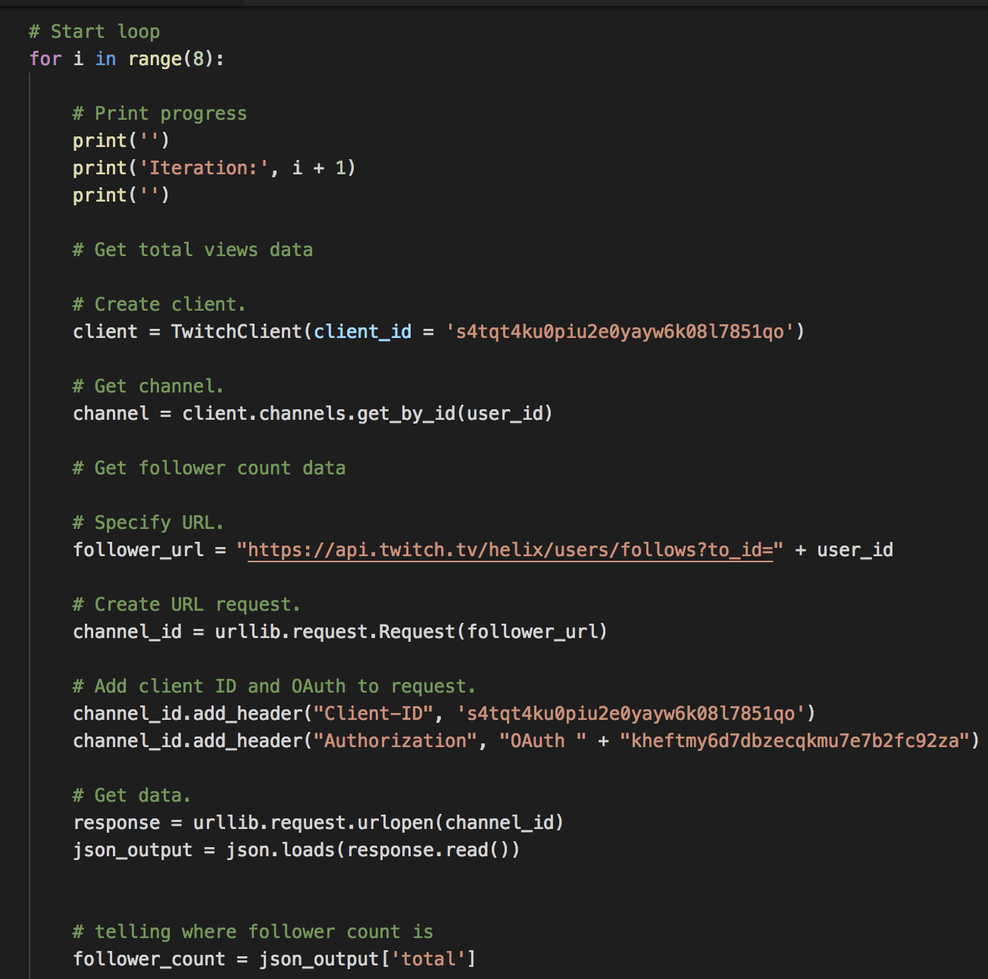
Twitch API Script
Step 2: Create a For Loop
Change the user_id every time you run script for a different streamer

Slide 5
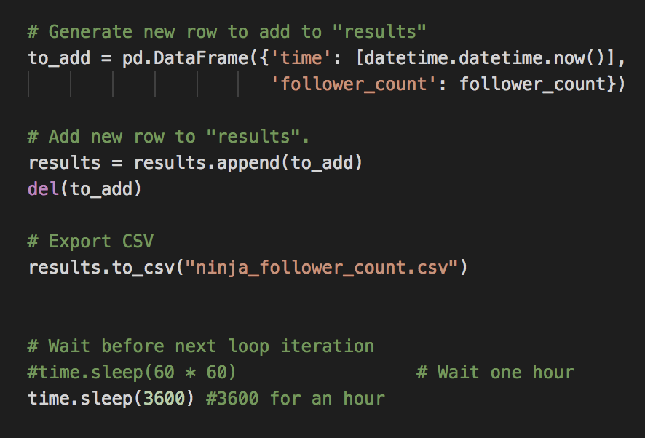
Twitch API Script
Step 3: Export Results to CSV and Sleep Script
Have results export to a pre-named CSV for each streamer with columns for the time of the ping and the follower count.
Make sure to change the CSV file name to correspond with the streamer you are running it for.
Sleep the script for 3,600 seconds(ie one hour) before it repeats itself

Slide 6
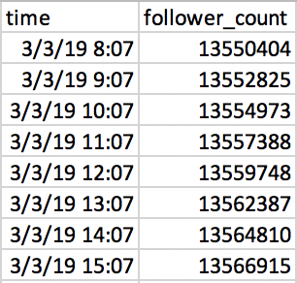
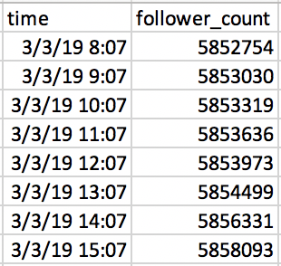
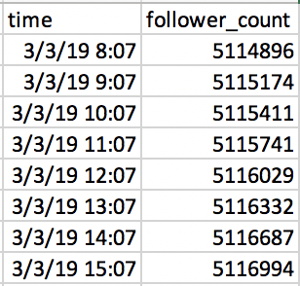
CSV Output
Ninja
Shroud
Tfue

Slide 7
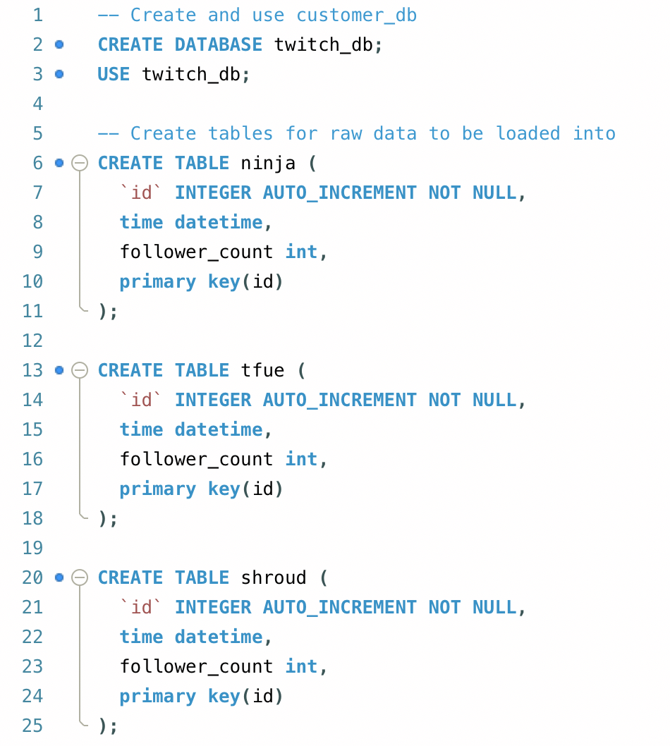
Creating SQL Database and Tables
Notes:
Each table is related in the way that they all ping the API at the same exact time, so the “time” column should equate within all tables; however, to make this clear to every user, we have added the “id” column to automatically increment, and be used as the primary key. Ideally, the ID column is what will be used to join the tables on each other.

Slide 8
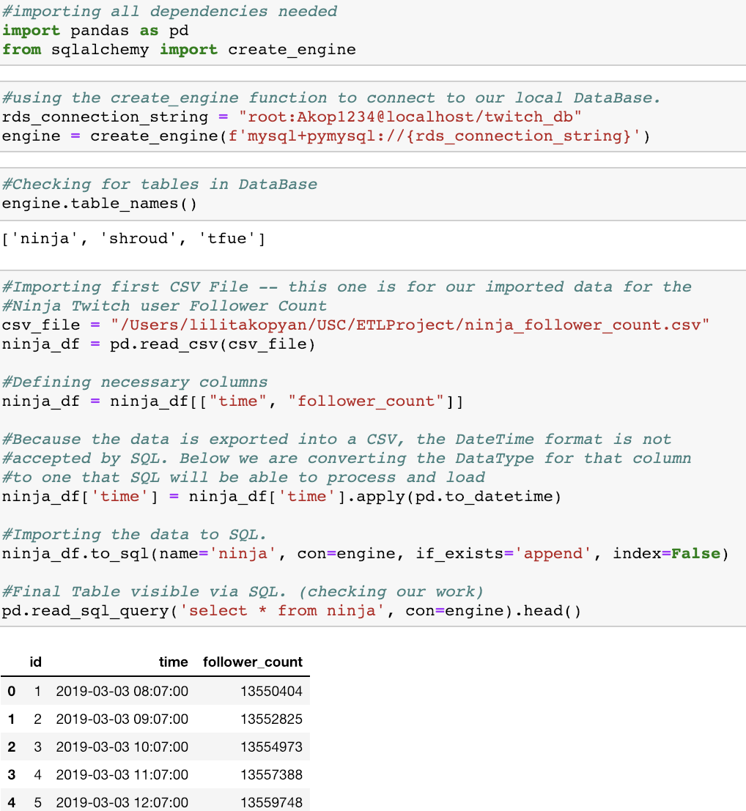
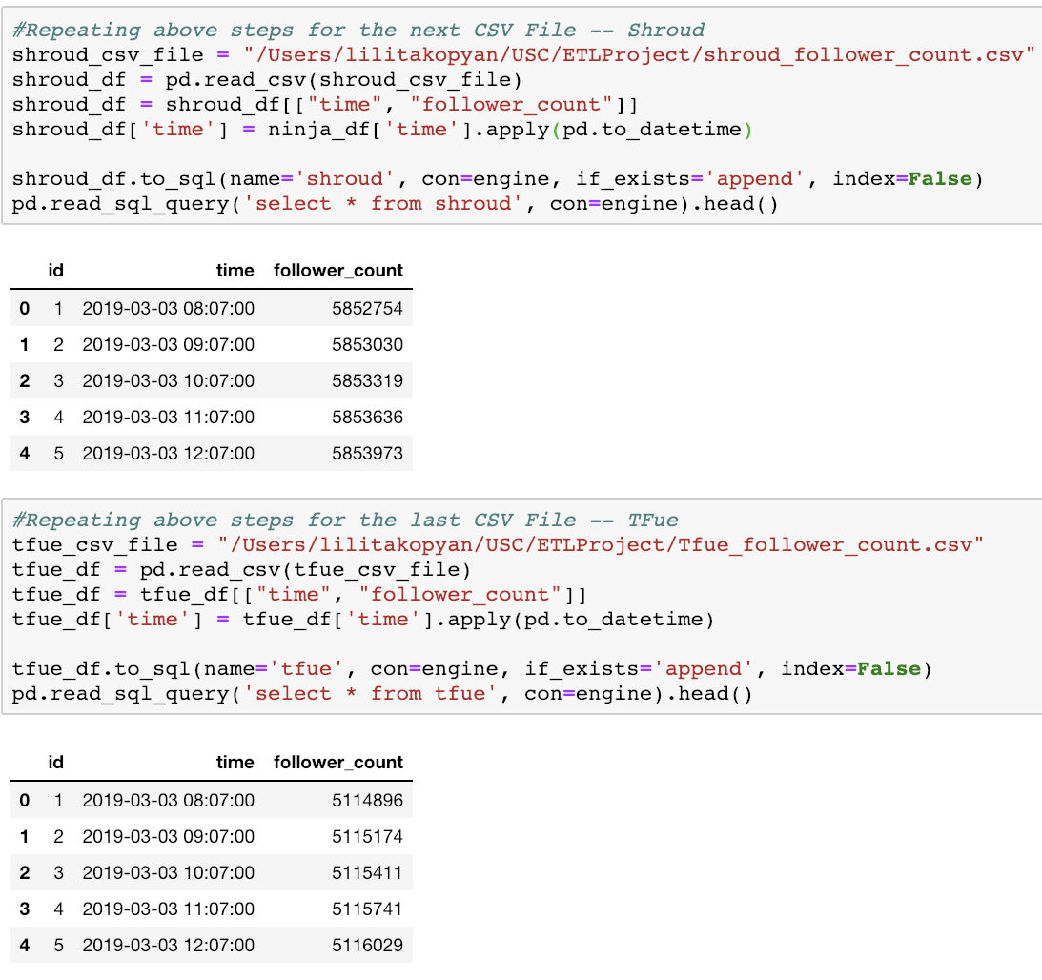
Using Pandas and SQLAlchemy to Load Data

Slide 9
ETL Process
Create three python scripts to get follower metrics for Ninja, Shroud and Tfou
Each python script connects to the follower API endpoint for Twitch
Each streamer has their own user_id which must be put into the script.
Run the python scripts for each User.
We ran this using our local machine; however, in a real-world example, this would be done using third party servers like Digital Ocean.
These servers would not allow us to immediately transfer our data directly into a SQL table, so we exported our data into CSV files.
Create SQL DataBases and Tables to account for all of our data.
Transfer data from CSV files to SQL using SQLAlchemy.

Slide 10
Potential Analysis
This could be used to compare the percent rate of growth for different gamers on the Twitch leaderboard.
It can also be used to compare gamers playing in the same gaming sector such as FPS.
Can be used to find potential gamers for companies to work with.

